Slide 1


Quant/Risk Presentation
Georgio Najm and Tevin Parathattal
November 17, 2025

Slide 2
Agenda
Overview of Our Risk Analysis Process
How We Estimate Beta and Alpha Using CAPM in Excel
How to Calculate Sharpe Ratio Using Excel
Python Demo

Slide 3
How We Estimate Beta and Alpha Using CAPM in Excel
Go to Wharton Research Data Services → CRSP
Click Stock/Security Files → Choose either Monthly or Daily Stock File
Choose Data Variable → Search Name or Type Ticker
Choose Query Variables: Click on “Returns” and “Return on S&P Composite Index”
Choose Query Output → Submit Form → Download Query Output (.xlxs) and open it
Go back to the Home Page → Fama-French Portfolios & Factors
Repeat Step 3
Select “(rf) Risk-Free Return Rate (One Month Treasury Bill Rate)”
Repeat Step 5
Copy and Paste Risk-Free Return Rates to the first Excel File
Compute Stock/Portfolio Excess Return
Compute S&P 500 Excess Return
File → Options → Add-ins → Select Analysis ToolPak → Go → Ok
In Excel → Data → Data Analysis → Regression
For Y input: Select Stock/Portfolio Excess Returns
For X input: Select S&P 500 Returns then click Ok to run Regression
Intercept is your Alpha and X variable is your beta

Slide 4
How to Calculate Sharpe Ratio in Excel
Click a cell → =STDEV.S(
Enter Range (Stock/Portfolio Returns) → Click Enter
Average Stock/Portfolio Returns
Divide Average Stock/Portfolio Returns by Standard Deviation to get Sharpe Ratio

Slide 5
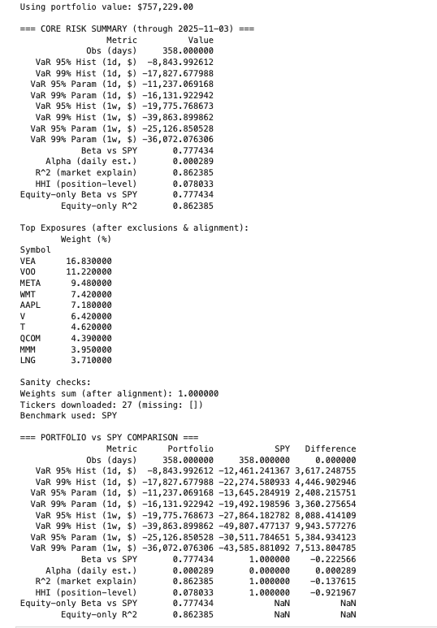
Python Demo
1. Clean & Normalize Holdings
Import positions, remove cash/non-investable rows, parse weights from % or market value, and renormalize to 100%.
2. Pull 10 Years of Price Data
Download daily adjusted prices for all tickers + SPY using yfinance; drop missing tickers and realign weights.
3. Build Portfolio Return Series
Convert prices to daily returns and compute weighted daily portfolio returns aligned with SPY.
4. Compute Risk Metrics
Historical & Parametric VaR (95/99%, 1-day & 1-week).
Beta, Alpha, and R² vs SPY.
Concentration via HHI and Top Exposures.
5. Run SPY-Only “Shadow Portfolio”
Apply the same VaR engine to SPY alone (beta=1, alpha=0, R²=1, HHI=1).
6. Final Output Table
Side-by-side comparison: Portfolio vs SPY risk, factor exposures, and concentration.

Slide 6
QUESTIONS?

